Slide 1
Asynchronous Web Apps
With Play Framework 2.0

Slide 2
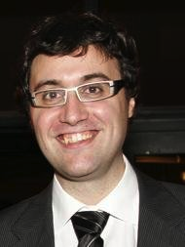




About me
Oscar Renalias
  oscarrenalias
  github.com/oscarrenalias
  oscar.renalias@accenture.com
  oscar@renalias.net

Slide 3
What we’ll do today

Slide 4

Why ?
Stateless
Asynchronous
Reactive
RESTful
Notes:
Stateless - TODO
Asynchronous - TODO
Reactive - TODO
RESTful - TODO

Slide 5
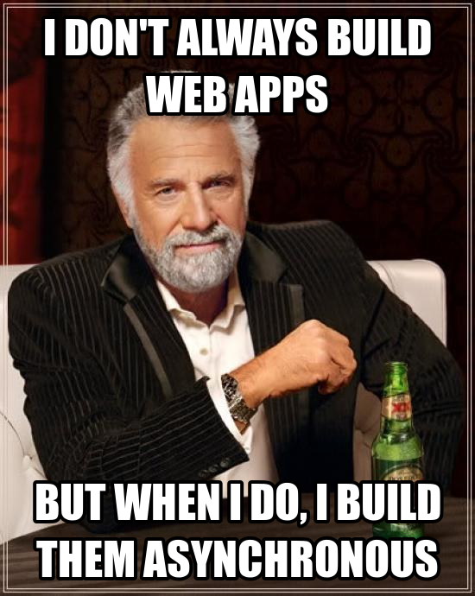
Scalability
Performance
Responsiveness
Usability
Notes:
Why asynchronous web apps?
Scalability – TODO
Performance – TODO
Responsiveness – TODO
Usability – TODO

Slide 6
Haven’t we done this before?
YES

Slide 7
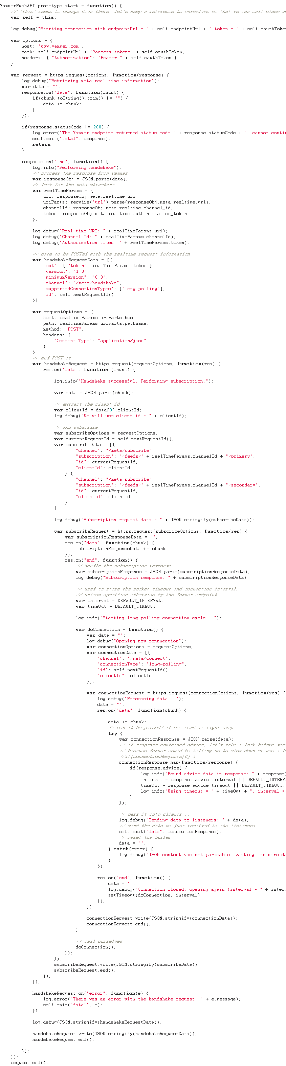
Callbacks
Callback handler!
Callback handler!
Callback handler!
Notes:
One of the best current examples of a framework or platform that provides asynchronous capabilities using callbacks is NodeJs. While it is a very powerful and flexible platform (together with frameworks such as Express), callback-hell is only a couple of callbacks away (e.g. web request that calls a database that calls a web service and returns the result).
There are ways around it (return continuations/functions instead of nesting them within the same block) but that’s not always used.

Slide 8
NIO
TODO: is there any example of asynchronous webapps with NIO or Netty? If not, delete this slide

Slide 9
Planning for the Future
A Future holds is a placeholder for a value that does not exist yet, because it is being or will be calculated – in parallel
Notes:
A Promise is a result generated by a future, that has not been “extracted” yet.
In Play, Promises are implemented on top of Akka’s Future.

Slide 10
This is the Future
val f = Akka.future {
longOperation()
}
val f2 = f.map(s=>handleContents(s))
f2.value.fold(
ex=> handleError(ex),
value=> handleOk(value)
)
Notes:
Technically, we could pretty much handle asynchronous operations like this except that at the end of the processing we would need to block the thread handling our action by requesting the value from the Promise to be unwrapped.
Can we do better?

Slide 11
Asynchronous responses
object MyController extends Controller {
def simpleAsyncAction = Action {
val p = Akka.future { Ok("Done") }
new AsyncResult(p)
}
}
Notes:
Replace Ok(“done”) with your own long-running business logic that returns a Result

Slide 12
Better Asynchronous Responses for asynchronous JSON
def betterAsyncResponse = Action {
Async {
Akka.future {
def orders = Action {
Async {
Akka.future {
SalesOrder.findAll
} orTimeout(Ok(Json.toJson(JsonError("Timeout"))), 5, java.util.concurrent.TimeUnit.SECONDS) map { orders =>
orders.fold(
orders => Ok(Json.toJson(orders)),
error => Ok(Json.toJson(JsonError("Error")))
)
}
}
}
Notes:
Async is a wrapper for what we’ve seen before and is the preferred way, and it basically takes a Promise[Result] and takes care of waiting for the result to be available, *asynchronously* and return it to the client.
If the content in the red markers is replaced with Json content instead of plain text responses, we’ve got ourselves a JSON API

Slide 13
Asynchronous web services
Async {
WS.url("http://.../").get().map { response =>
Ok(someJsonContent(response))
}
}
Notes:
What if we could do web service calls to other RESTful endpoints asynchronously, and leave the framework the responses whenever they’re ready?
Meet WS.url.
WS.url.get()/post()/etc return a Promise – result: we don’t have to do anything special; let the request finish, do something with its contents, return the promise and let the framework handle the response to the client whenever it’s ready. EPIC WIN.

Slide 14
Enumerators & Iteratees
Enumerators = sources of data (“events”)
Iteratee = consumers
Enumerator → Iteratee → Client

Slide 15
Enumeratees
Enumerator → Enumeratee → Enumeratee → Iteratee → Client

Slide 16
Streaming APIs
Enumerators and Iteratees provide the foundations for implementing event-based streaming APIs

Slide 17
WebSockets

Slide 18
A glimpse of the future
Reactive Mongo

Slide 19
All work and no makes Jack a dull boy (but there’s still hope)
Snippet of Servlet 3.0 + Grails
Notes:
Can’t work with Play? No problem!

Slide 20
All work and no makes Jack a dull boy (but there’s still hope)
Sample of Java Vert.x
Notes:
Can’t work with Play? No problem!

Slide 21
